Slide 1
economic conditions in Manufacturing
February 18, 2021
Joe Mahon
Regional Outreach Director

Slide 2
DISCLAIMER
The views expressed here are the presenter's and not necessarily those of the Federal Reserve Bank of Minneapolis or the Federal Reserve System.

Slide 3
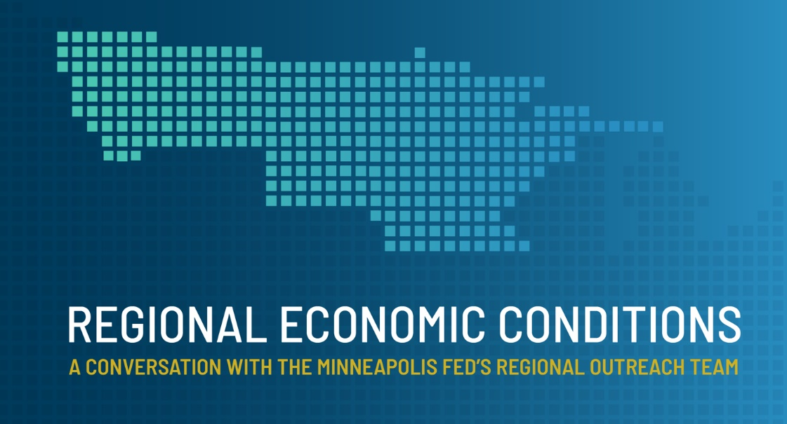
Regional economic conditions
REC: A new webinar series from the Minneapolis Fed
Extension of annual Regional Economic Conditions Conference connecting people & research related to Ninth District economy
More surveys and more real-time data being gathered
Webinars help Bank connect w/ business and community leaders about real-time conditions in the Ninth District
Enhanced data sharing: Greater value for survey partners and survey participants

Slide 4
Today’s presentation
The Federal Reserve
  The Ninth District
Manufacturing sector
Survey results
  2020 a bad year
  Outlook optimistic
Pandemic impacts

Slide 5
Today’s presentation
The Federal Reserve
  The Ninth District
Manufacturing sector
Survey results
  2020 a bad year
  Outlook optimistic
Pandemic impacts

Slide 6
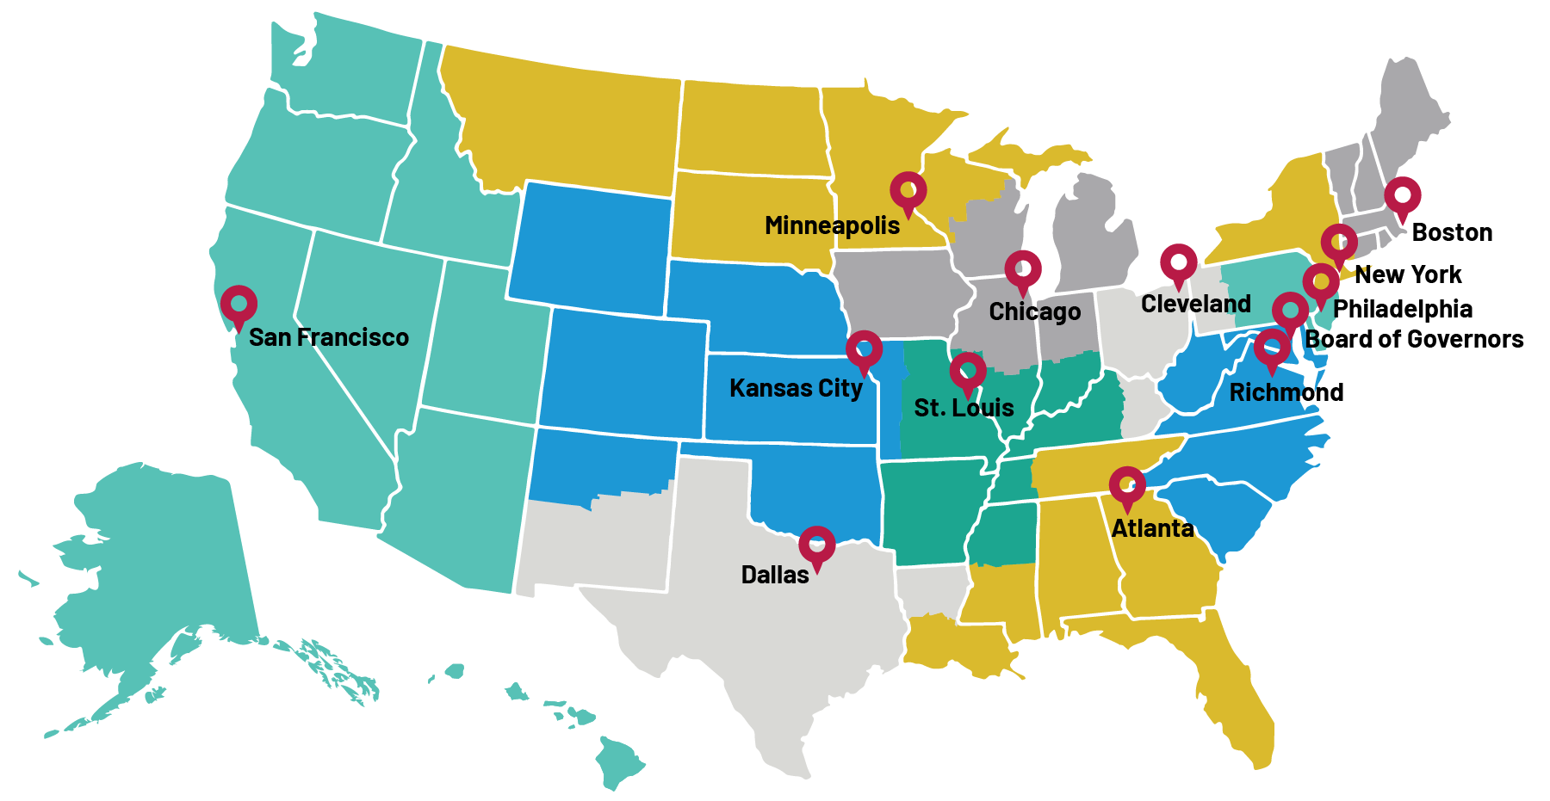
The Federal Reserve

Slide 7
Federal Reserve Bank of Minneapolis
The Federal Reserve
MT
ND
MN
MI
WI
SD
Incorporated and opened in 1914
Helena Branch established in 1921
The Ninth District
  Includes Minnesota, Montana, North Dakota, South Dakota, the Upper Peninsula of Michigan, and northwestern Wisconsin
  A diverse economy, from mining to tourism to agriculture to technology

Slide 8
Today’s presentation
The Federal Reserve
  The Ninth District
Manufacturing sector
Survey results
  2020 a bad year
  Outlook optimistic
Pandemic impacts

Slide 9
Output by industry, 2019, U.S. & Ninth District
Source: Bureau of Economic Analysis

Slide 10
Employment by industry, 2020, U.S. & District
Source: Bureau of Labor Statistics

Slide 11
Today’s presentation
The Federal Reserve
  The Ninth District
Manufacturing sector
Survey results
  2020 a bad year
  Outlook optimistic
Pandemic impacts

Slide 12
Manufacturing in contraction
Survey results
Ninth District survey
  Conducted December and January, looking backward and forward one year
  Random sample of manufacturers, polled via mail
  Stratified by state and firm size
  All states, 476 respondents
Conducted in partnership with Minnesota DEED

Slide 13
No Surprise, 2020 was difficult
Survey results
*Index number above 50 indicates expansion.
Index number below 50 indicates contraction.

Slide 14
Worst results since great recession
Survey results
*Index number above 50 indicates expansion.
Index number below 50 indicates contraction.

Slide 15
2021 expectations call for growth
Survey results
*Index number above 50 indicates expansion.
Index number below 50 indicates contraction.

Slide 16
optimism consistent with “typical” year
Survey results
*Index number above 50 indicates expansion.
Index number below 50 indicates contraction.

Slide 17
State Economic outlooks positive, but less so than last year
Survey results
*Index number above 50 indicates expansion.
Index number below 50 indicates contraction.

Slide 18
Today’s presentation
The Federal Reserve
  The Ninth District
Manufacturing sector
Survey results
  2020 a bad year
  Outlook optimistic
Pandemic impacts

Slide 19
impact of the COVID-19 Pandemic on your business
Pandemic impacts

Slide 20
In your opinion, how long will it be before your business goes back to normal operations?
Pandemic impacts

Slide 21
Thank you!
Speech referrals welcome!
@MinneapolisFed
Joseph.mahon@mpls.frb.org
Or Connect on LinkedIn

