Slide 1
Comments on
“Retirement in a Life Cycle Model of Labor Supply with Home Production”
Authors: Rogerson and Wallenius

Slide 2
Question: why do so few people work part time?
  Retirement: often a transition from full time work to no work
  Explanations given
Commuting time
Tied wage hours offers (part time wage penalty)
Home production

Slide 3

Non-convex budget sets part time wage penalties and commuting time
Offered wage is a function of hours:
Within period income
leisure
h

Slide 4
Non-convex budget sets and reservation hours level
Indifference Curve
Within period income
leisure
(h(e) – h)=
reservation hours level
h

Slide 5


Use FOCs to derive
Agents maximize
Where e=retirement age, h(e)- = “reservation hours level”

Slide 6
Calibration
Suppose time endowment=5840 hours per year, h(e) - =2000,
=.4, IES=0.5
=890 hours per year to satisfy the equation
This seems implausibly large
= 200-250 hours
(Juster and Stafford (1991), Black et al. (2009))

Slide 7
And home production does not help

Slide 8
Praise
I learned a lot from thinking about this equation
  Importance of non-convexities
Captures key insights on labor supply
  Intensive and extensive margins
  Effects of taxes on both intensive and extensive margins
  In a simple tractable framework

Slide 9
An alternative calibration
French (2005): dynamic programming model, similar features to Rogerson-Wallenius, claims non-convexities can explain lack of part time workers
  French (2005): =335
Pick new values for
  h(e) -
Allow for
  Work related expenses (gas, clothes, etc.)

Slide 10
Distribution of hours worked last year, PSID, 1968-2003, men ages 25-70
Note: 40 hours/week × 50 weeks/year = 2000 hours/year
Deciles of hours distribution
10th: 0
11th: 1
20th: 1259
30th: 1800
40th: 1960
50th: 2030
60th: 2121
70th: 2300
80th: 2500
90th: 2904
Mean (non-zero): 2119

Slide 11
Distribution of hours worked last year, PSID, 1968-2003, Married Women ages 25-70
40th: 0
45th: 1
50th: 358
60th: 1040
70th: 1593
80th: 1920
90th: 2040
Mean (non-zero): 1494
Cogan (1981): h(e) - = 1,000 hours per year

Slide 12
Hours and Participation over the life cycle
Men, PSID data (from French (2005))
Average hours does not fall below 1000 hours/year
Estimated life cycle model: h(e)- =1000 hours per year

Slide 13
Some estimates of work related expenses
Expenditures fall about 15% at retirement.
Most of this is on work related expenses (food out, transport, adult clothing).

Slide 14
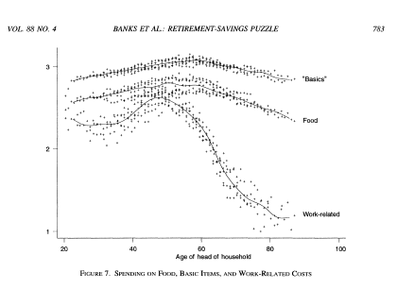
Estimates of work related expenses from Banks, Blundell, Tanner, 1998

Slide 15
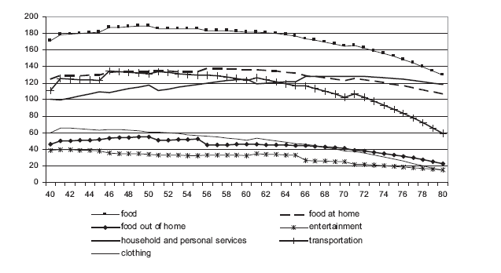
Further decomposition of spending
Aguila, Attanasio, Meghir (2008)
Biggest work related expense: transportation
(seems like an expense, not an input to home production)

Slide 16



Modify equation of paper
Where = money costs of work per unit of time spent working
Use FOCs to derive

Slide 17
part time wage penalties, commuter costs, and other work related expenses
Within period income
h(e) - h
leisure
h

Slide 18
Suppose time endowment=5840 hours per year, h(e)- =1000,
=.4, IES=0.5
Work for ¾ of one’s life
Average of 2000 hours per year when working =X*(average consumption)
Question: What combinations of ( , X) satisfy modified equation?
(0,0.25) | (150,0.2) | (250, .15) | (320,0.1) | (520, 0)
We can make ( , , X) smaller if time endowment is smaller, or IES, bigger

Slide 19
Conclusion
Great paper, but why such a negative view of non-convexities that we can measure?

