Slide 2

The Mission of the Center for Indian Country Development
We support the prosperity of Native Nations through actionable research and community collaboration.
The Mission of [Tribal Ambassador’s organization/institution]

Slide 3

Overview
Why homeownership? Why now?
The tribal leader’s role in creating opportunities
Tribal Leaders Handbook on Homeownership
Notes:
This session is designed for tribal leaders to better understand their role in developing homeownership opportunities and to walk away with informed ideas on action steps they can take when they return home.
Tribal Leaders Handbook on Homeownership is a comprehensive resource for tribal leaders, housing authorities, TDHEs, lenders, and community partners to better understand the lending landscape so they can learn about the process or expand their existing programs.
The Center for Indian Country Development of the Federal Reserve of Minneapolis launched its homeownership initiative in 2016 and established the National Native Homeownership Coalition (NNHC) to support the prosperity of Native Nations through actionable research and community collaboration.
The Handbook is available and can be downloaded on the Center’s website. Hard copies by request.
The NNHC’s slogan “MORE BETTER FASTER” – promoting an action-oriented process with steps and stages along the continuum of lending. Ask tribal leaders what action(s) can be taken by “next Tuesday,” such as requesting an inventory of housing units in the community by type (rental, rent-to-own, homeowner). Help steer them away from a mindset of inertia / status quo and that change requires endless meetings.

Slide 4
Why Homeownership?
Demand: High need for homes and desire to be
homeowners
Capacity: Improved income and credit scores
Culture & Community: Indian Country as a place to raise families
Resources: Maximize limited resources and assets
Notes:
Mortgage lending is a market opportunity in Indian Country. Demand and capacity to serve the community, especially on trust lands. Many opportunities for Native-serving financial institutions to collaborate on delivering mortgage lending products.
Tribal Members want to own their own homes and there is a growing number who can afford a mortgage
75% of reservation residents report a strong desire to own their own home (2017 HUD study).
Tribal economies and the financial capacity of tribal members are growing.
Rising middle class and need of homes for working professionals, especially for commuters form border towns. On some reservations, over 70% of the workforce commutes.
Over 40% of reservation households have income over the U.S median.
Credit risk scores are on the rise (p. 58 in TLHH). Over 50% of borrowers living on reservations already have prime credit scores.

Slide 5
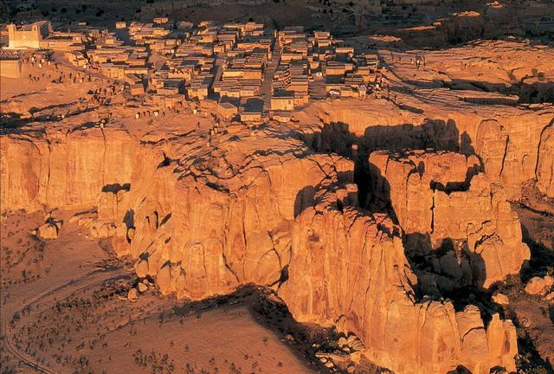
Culture and
Community ~
Wherever you are from in
Indian Country
Notes:
Culture and Community
Strengthens Native peoples’ ties to their history, land, language, and culture.
Offers tribal citizens stable, long term residence, an investment for families, and inheritance.
Builds assets for future generations
Give examples from your community

Slide 6

Reservation economies and self-determination
Notes:
Improves Reservation Economies
Leverages tribal housing resources
Housing options at all income levels
Addresses housing shortages and opens up rental units
Supplements NAHASDA and IHBG funds
Employment and workforce development.
Builds financial capability.
Spur manufacturing, retail, and business growth.
Sovereignty and Self-Determination
We will identify and resolve the issues we face on our own terms, using our own people, and using our own institutions.
Unlock he potential of reservation lands. Tribal destiny in tribal hands.
Fundamentally strengthens tribal governing institutions at every level.
Governed by tribal law and legal infrastructure
Promotes self-sufficiency at tribal and individual levels
Meets demand for housing and provides choices

Slide 7
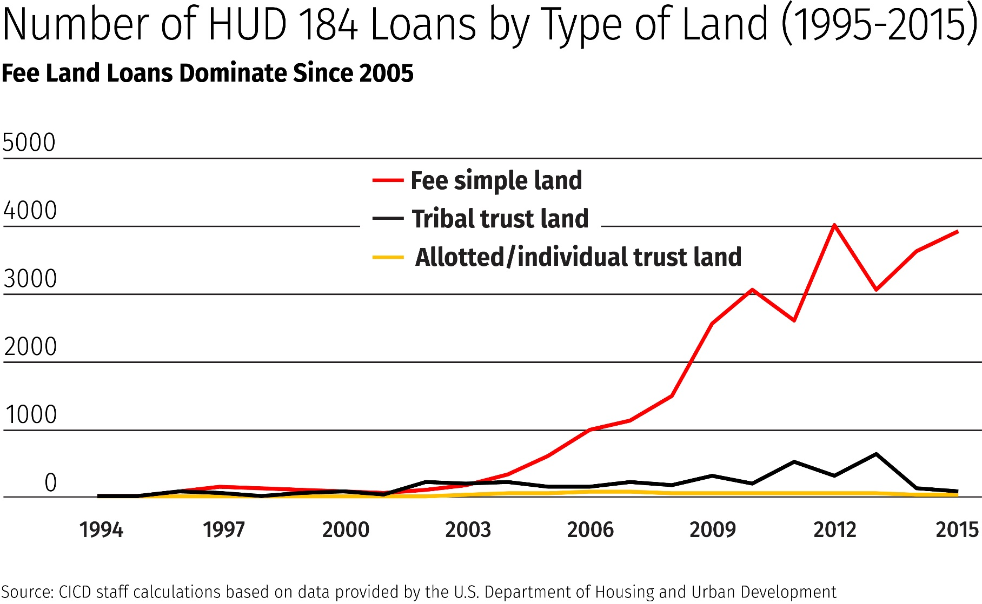
This Trend Concerns Me
Notes:
Despite the demand for homeownership on reservations, 90% HUD mortgage lending on fee land, not trust land–program designed specifically to promote homeownership and stimulate housing development on reservations. In fact in the past 25 years of the program, The HUD 184 loan has for the most part bypassed Indian Country. That is $1.4 billion that is not reaching Indian Country.
The red line takes off the year that the HUD 184 made available to AIAN residing off reservation.
The steep curve means the reservation and trust lands are not being used or developed for housing. This is consistent with our finding that it can be difficult to lend on trust lands, even with a very desirable loan product. This was a major impetus for the CICD’s National Native Homeownership Coalition and the eventual Tribal Leaders Handbook on Homeownership – to navigate this process and help streamline lending systems.
This is not good for people who want to work and live on the reservation. Tribal professionals and people who would like to live on the reservation to be near their family and work but cannot find suitable housing

Slide 8
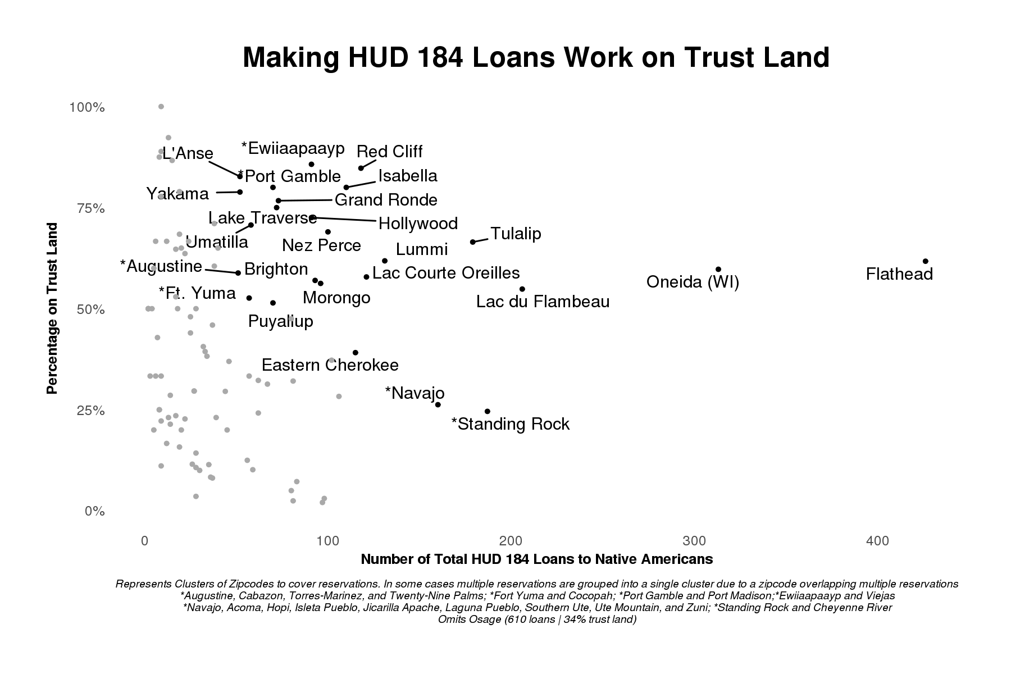
Tribes Making HUD 184s Work on Trust Land
Notes:
Despite the challenges of lending on trust lands, many tribes have established successful mortgage lending programs. This graph depicts tribes that are doing a lot of mortgage lending on trust land.
Top right is ideal– high volume of loans, majority on trust lands.
These tribes understand the needs of their community and have created tribal codes, policies, homeownership programs, and relationships with key institutions (banks, construction companies, federal agencies, community organizations).
Through case studies we find it’s about tribal self-governance and institution building.

Slide 9
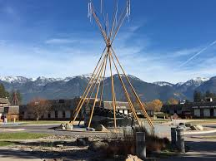

Sovereign Lending: A Bright Chance for Survival
Notes:
Confederated Tribes of Salish and Kootenai uses multiple approaches
Promotes expectation of both rental payment and loan repayment
Compacts land management functions
Fosters vibrant real estate market on trust land
Uses master lease to facilitate transfer of mortgages
Provides homebuyer education and down payment assistance
With longer sessions, play Sovereign Lending Video (11 minutes)

Slide 10
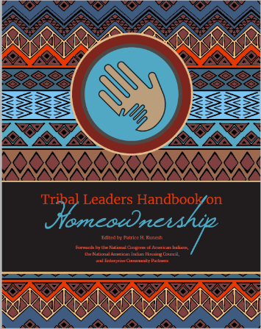
Tribal Leaders Handbook on Homeownership
A blueprint for tribal leaders, lenders, homebuyers, and their partners:
Overview of land lease and mortgage lending processes
Housing needs assessment and homebuyer readiness resources
Resources on financing and making homeownership affordable
Notes:
Tribal leaders requested a “how-to” guide or homeownership toolkit. In response, the CICD partnered with Enterprise Community Partners to create the Tribal Leaders Handbook on Homeownership. The Handbook is available on line on the CICD Website.
What does the Handbook cover?
Share case studies of successful homeownership efforts
Highlight resources provided in appendix

Slide 11
The special role of tribal leaders
Governance Role
Enact laws
Oversee land management
Practitioner Role
Build and sell homes
Provide homebuyer education
Define foreclosure process
Secure down payment assistance

Slide 12

What can tribal leaders do?
Understand housing needs and homeownership capacity – surveys and community meetings
Establish legal infrastructure and land management systems
Develop partnerships with lenders and developers
Notes:
Understand how homeownership impacts the social and economic health of the community can be done both quantitatively and qualitatively. Resources are available on the CICD Website (“Getting Started,” Homeownership Assessments)
Start with small scale outreach to community members from across the spectrum: tribal professionals, struggling family members, community service professionals, business owners, anyone who may inform your decision making.
Deliver a community-wide homeownership needs assessment, construction planning, financing, and the type of support programs the tribe offers.
Prioritize the governmental functions that provide certainty for lenders, homebuyers, and other stakeholders in involved in the homebuying and mortgage process.
Develop and improve tribal legal infrastructure with sound, consistent, tribal mortgage codes grounded on industry standards, followed up enforceable remedies. Effective tribal codes and courts help create an environment that encourages investment and lending, i.e. reliable recourse for defaulted payments and foreclosure.
Recognize the tribe’s role in the case of a mortgage delinquency, default, and foreclosure.
Create a tribal Leasing, Title, and Records office by assuming responsibilities from the BIA and/or establishing a residential leasing program under the HEARTH Act. Tribes then control some of the most important functions of the mortgage process.
Support homebuyer readiness and partner with TDHEs to deliver tribally sponsored homebuyer education and readiness program.
Develop a step by step guide describing the processes for homebuying, including unique processes for the tribe, homebuyer, and lender, to finalize a mortgage on trust land.
Develop partnerships with lenders and others. Negotiate with state and federal agencies, private lenders, and investors to access government and conventional loan programs.

Slide 13
Presenter inserts examples
from his/her community
Notes:
This slide is optional, but presenter could insert a slide and discuss example(s) of what his/her community does to create opportunities for homeownership.

Slide 14
Curriculum and training available in 2019!
For announcements on training and resources subscribe to the CICD and NNHC newsletters!

Slide 15
For more information:
Center for Indian Country Development
Federal Reserve Bank of Minneapolis
cicd@mpls.frb.org

